Slide 1

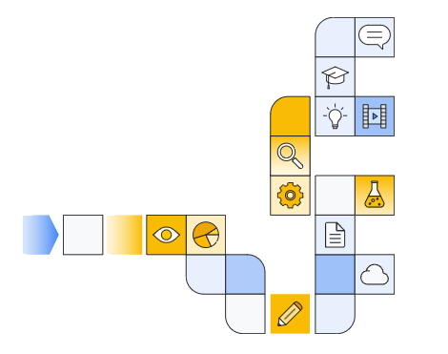

Google cloud generative ai overview
Notes:
https://www.cloudskillsboost.google/paths/118/course_templates/388

Slide 2
Generative AI Products in google Cloud
Notes:
https://www.youtube.com/watch?v=j0f-YDWxJmM&t=1s

Slide 3
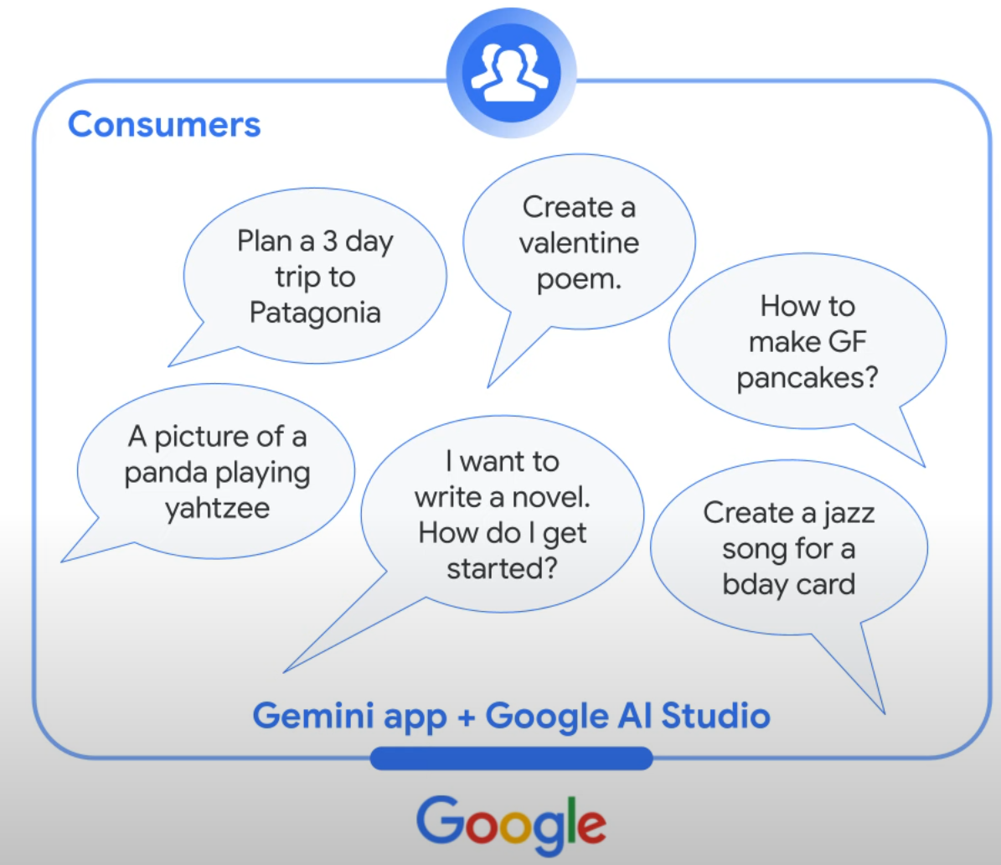

Slide 4
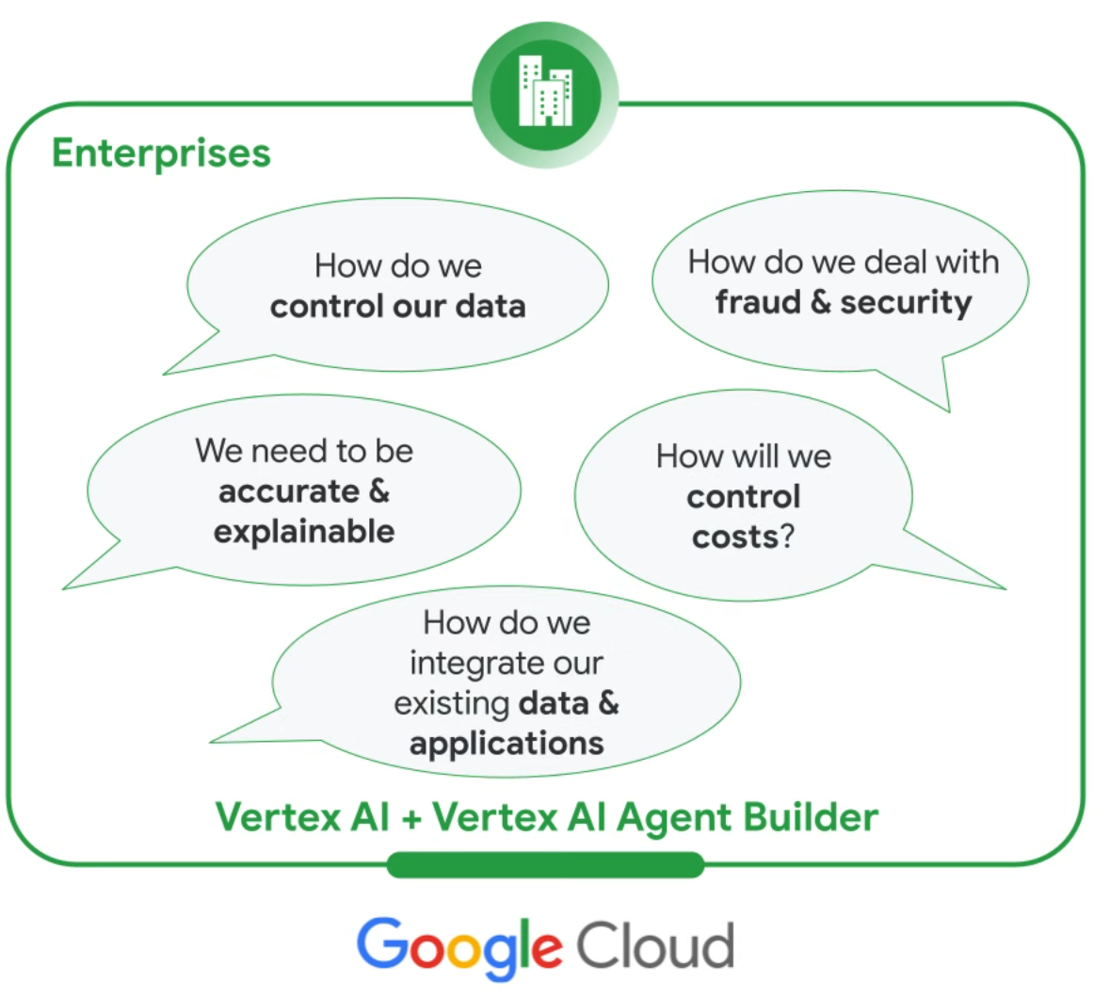

Slide 5
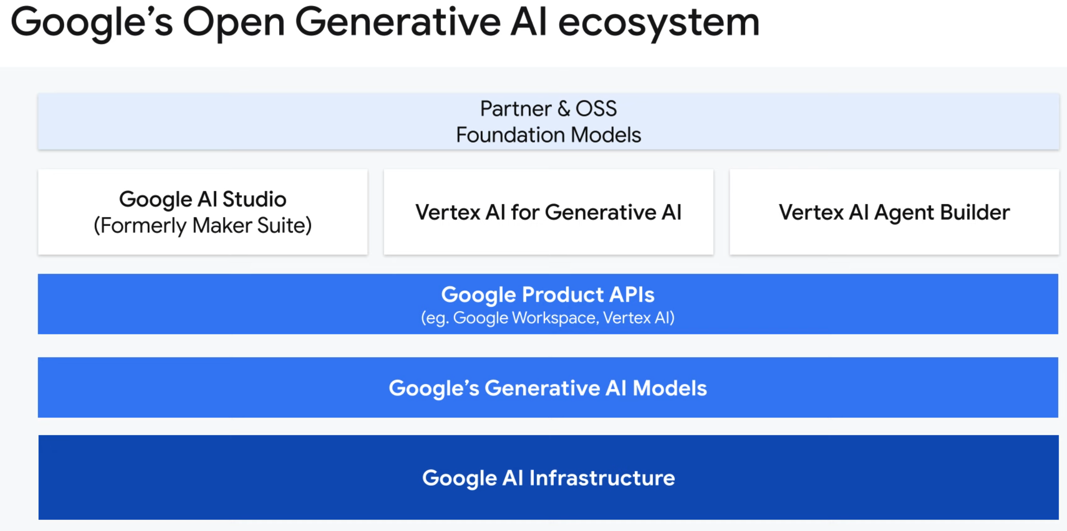

Slide 6
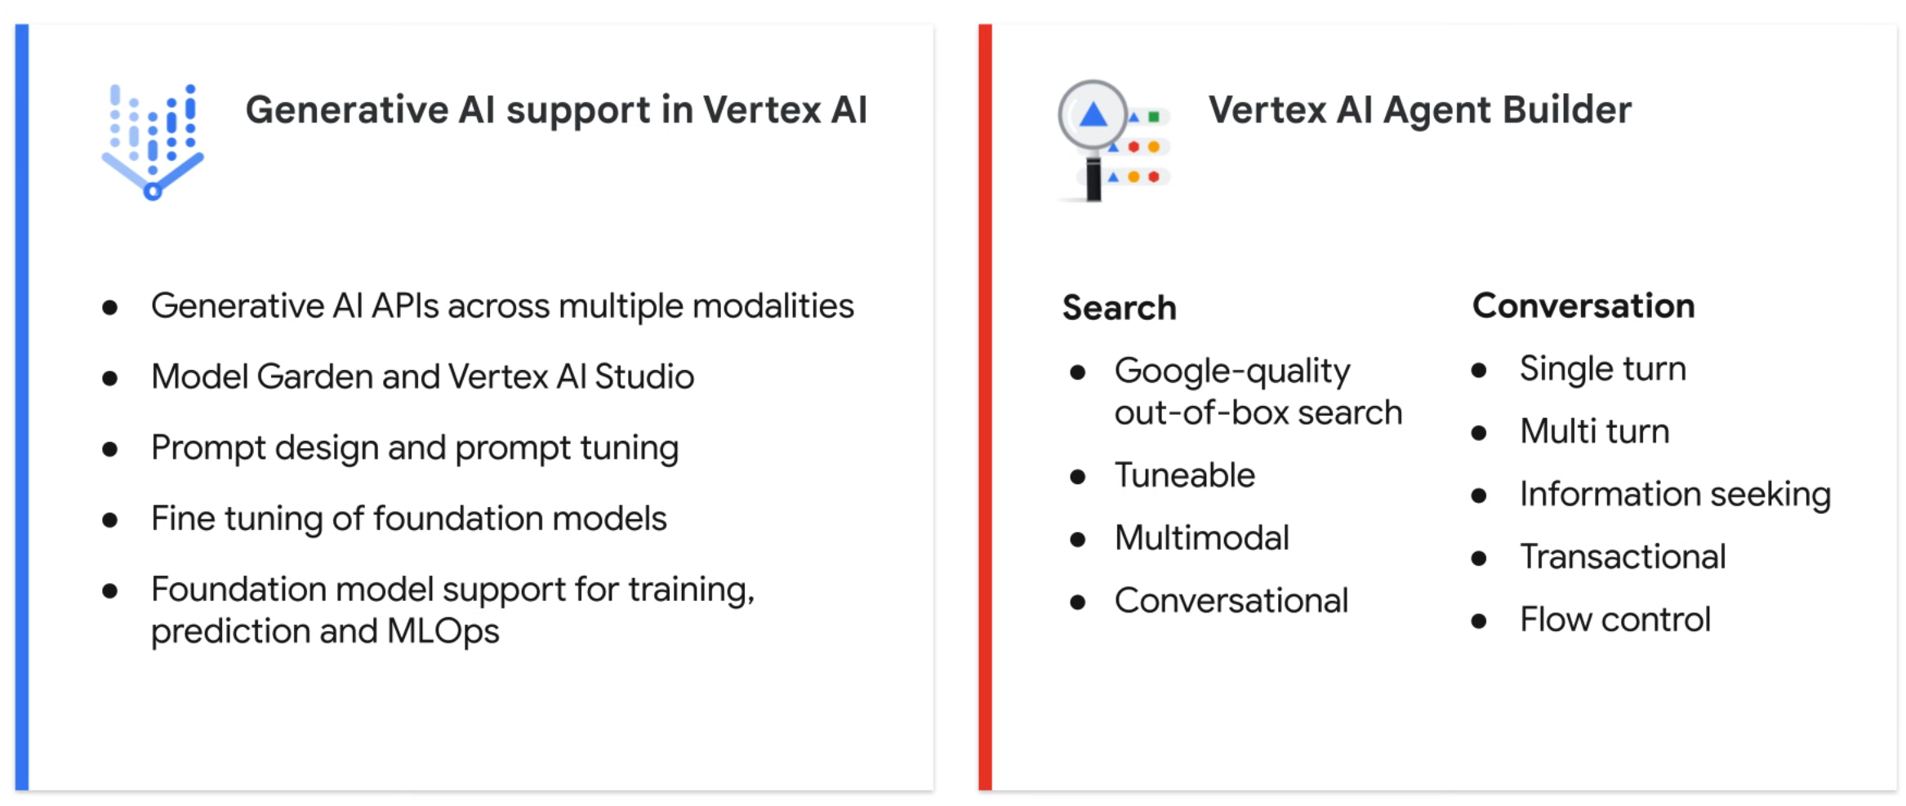

Slide 7
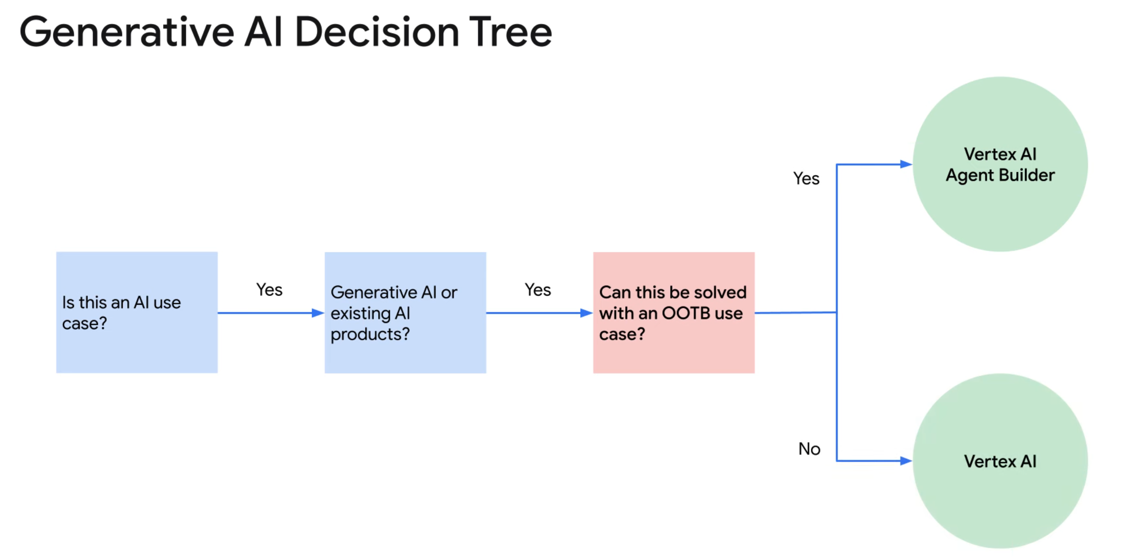

Slide 8
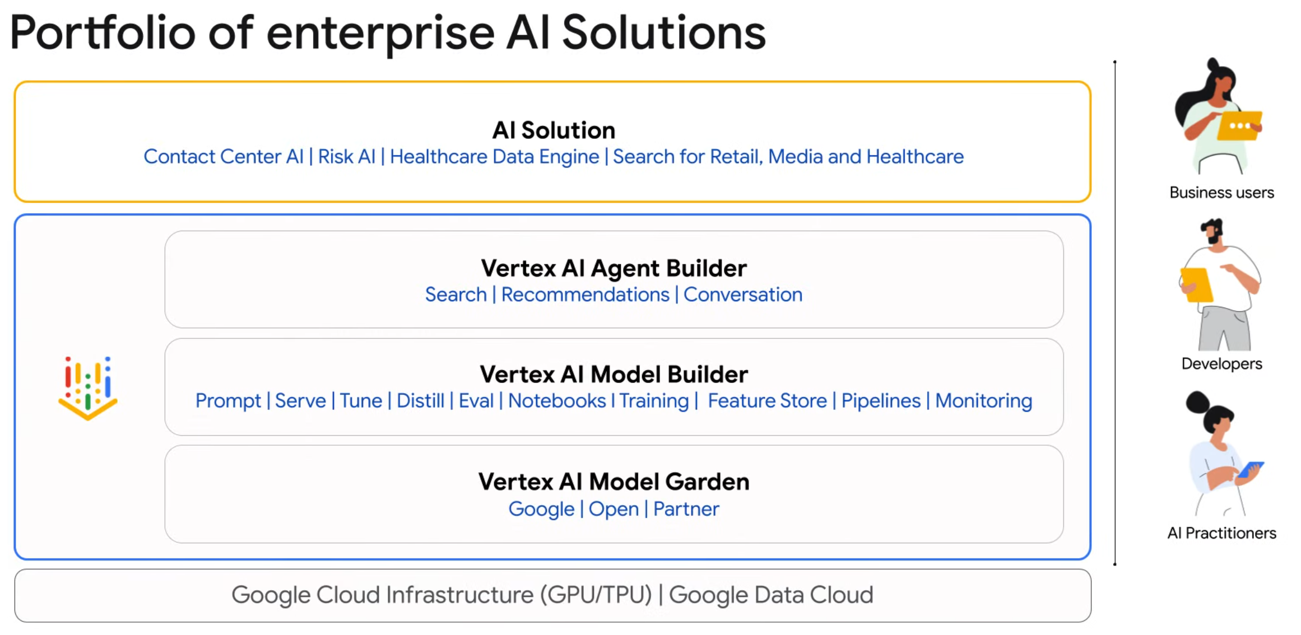

Slide 9
Vertex AI Agent Builder: Vertex ai Search & Vertex Ai Search for Retail
Notes:
https://www.youtube.com/watch?v=LZh9ZIIg0ko&t=1s

Slide 10
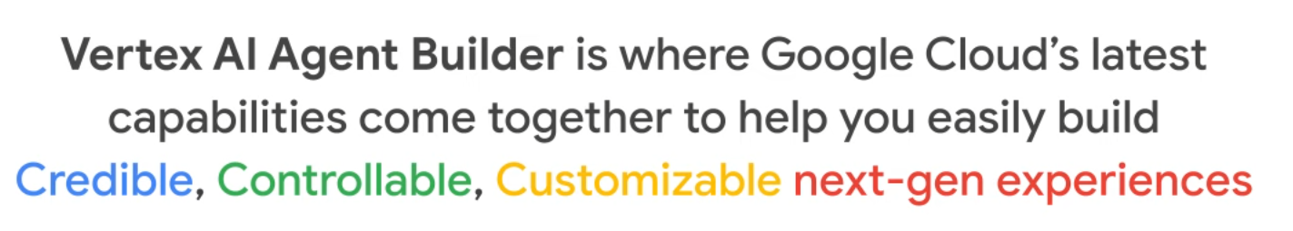

Slide 11
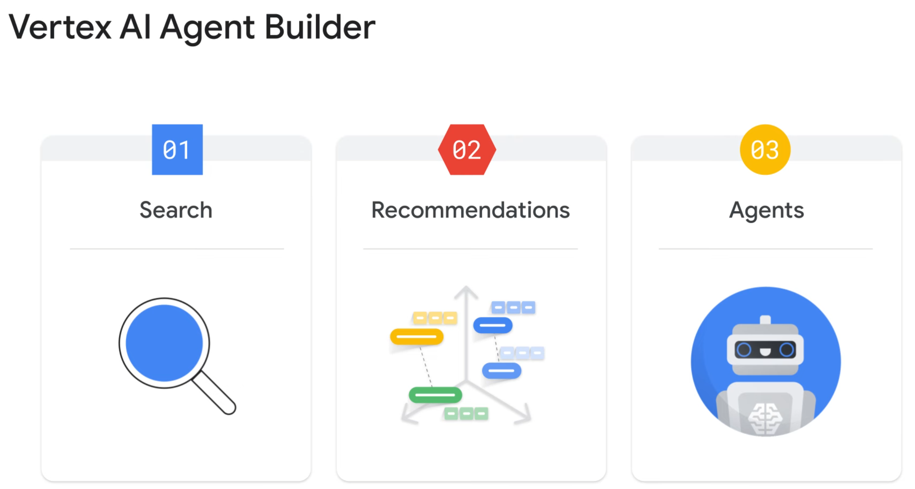

Slide 12
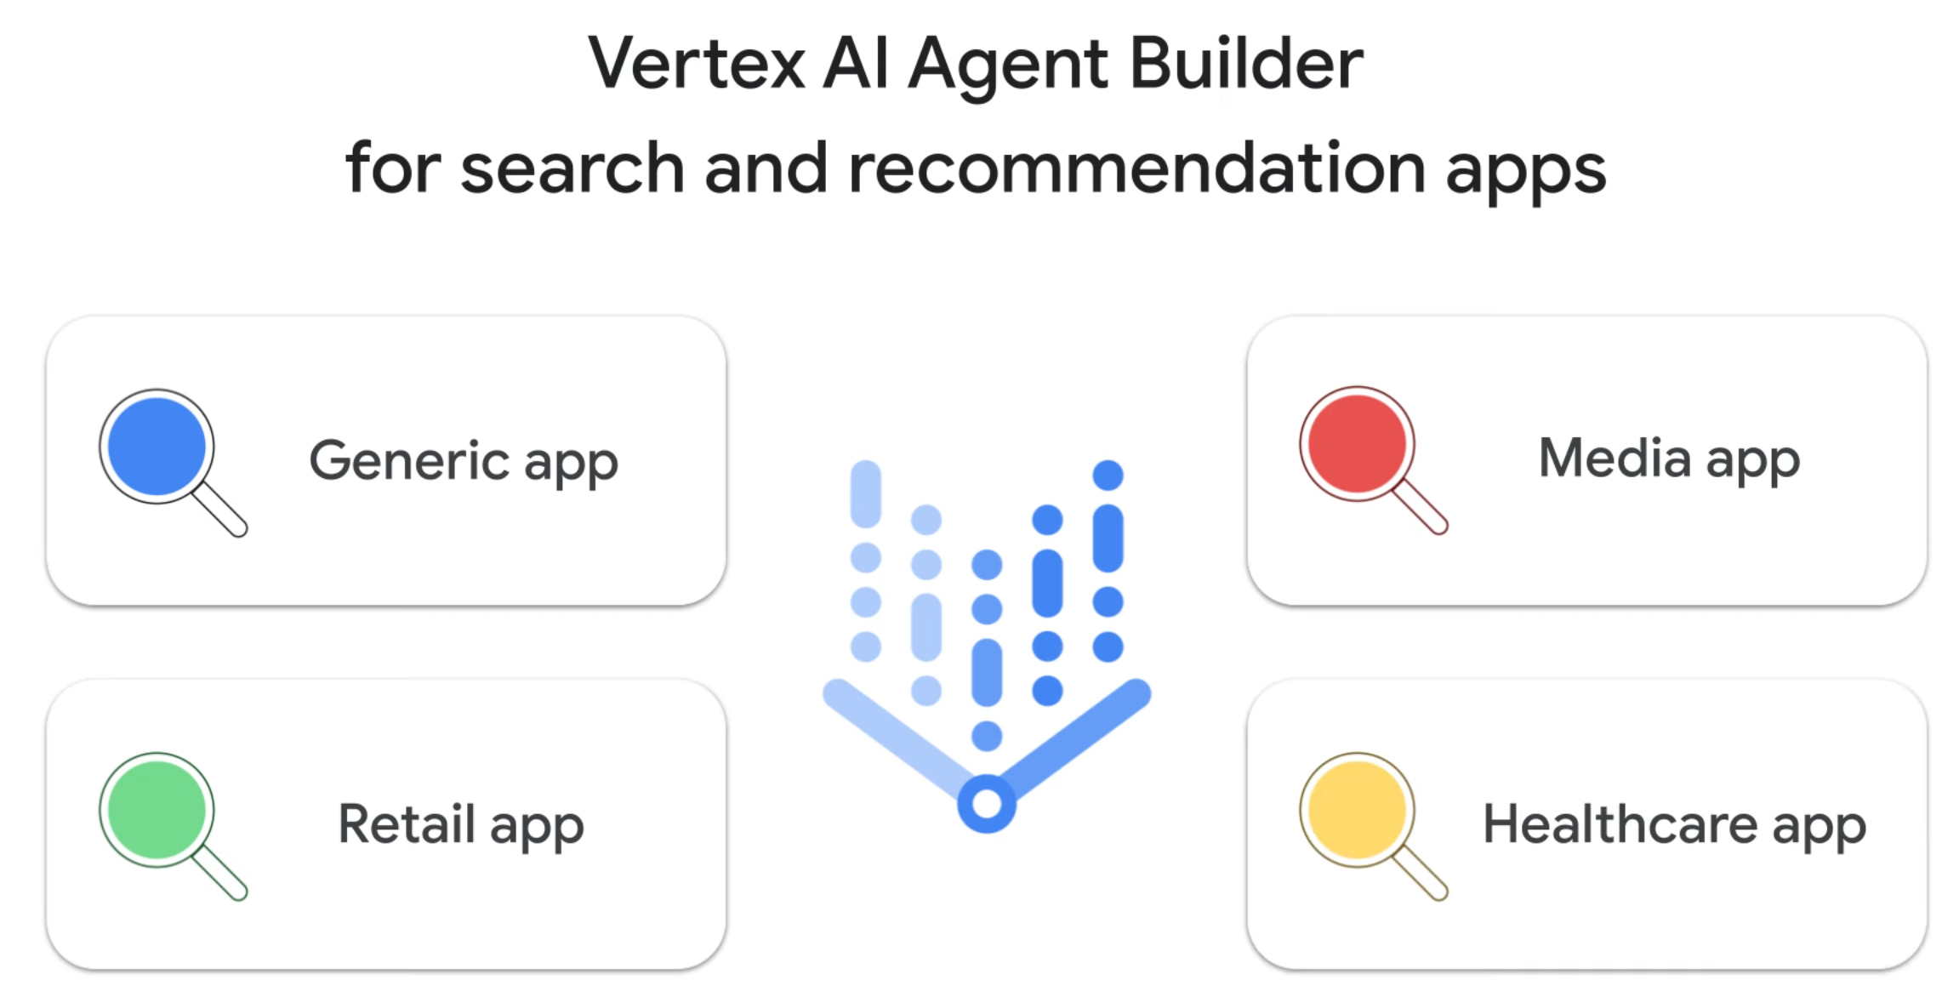

Slide 13
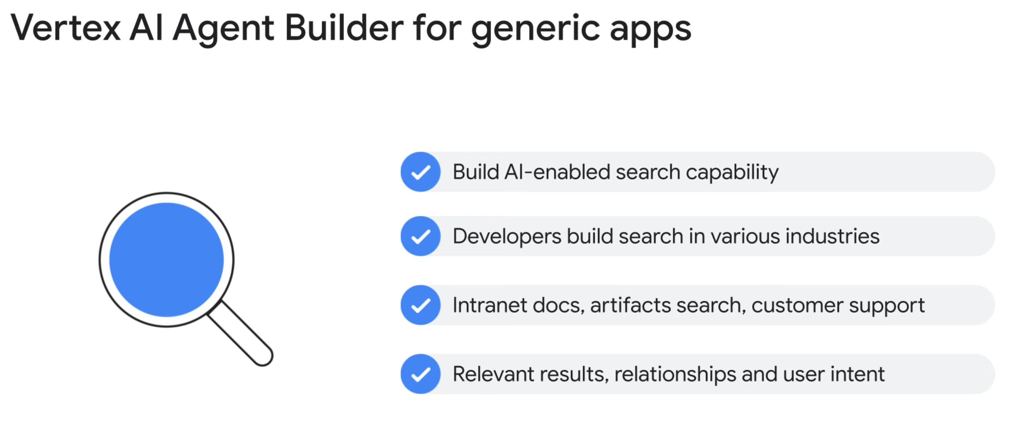

Slide 14
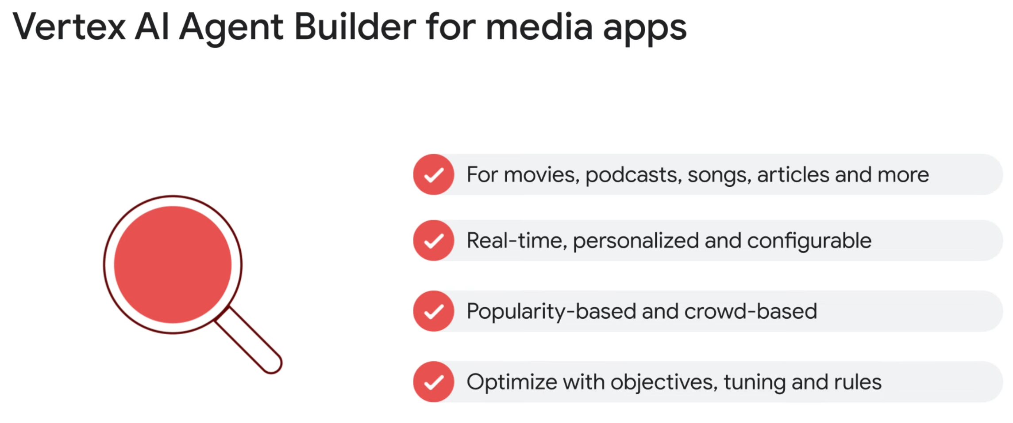

Slide 15
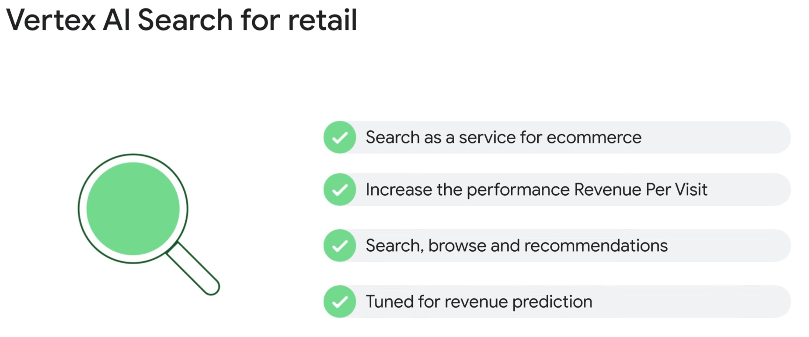

Slide 16
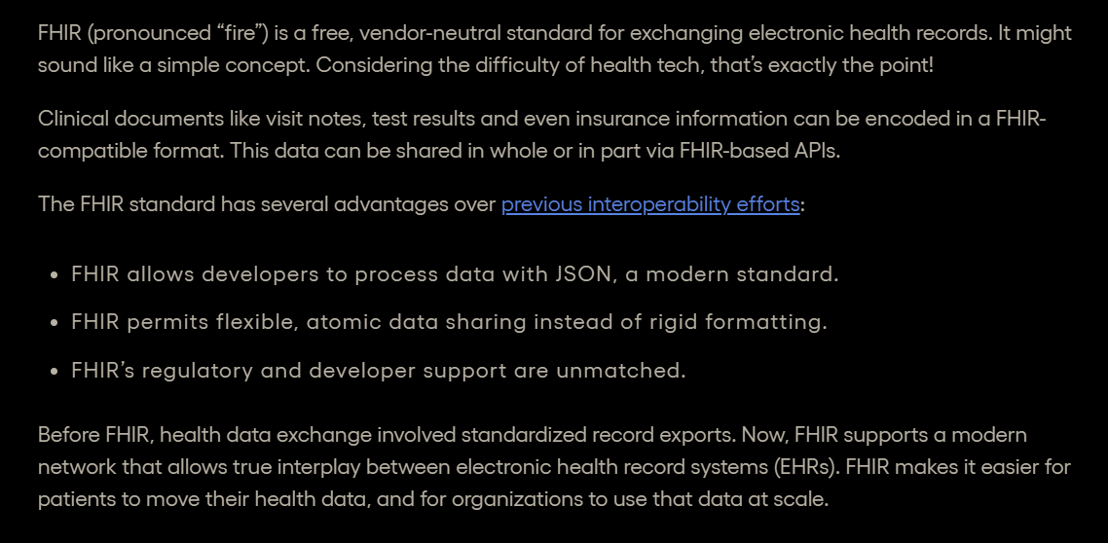
Notes:
https://www.particlehealth.com/blog/what-is-fhir

Slide 17
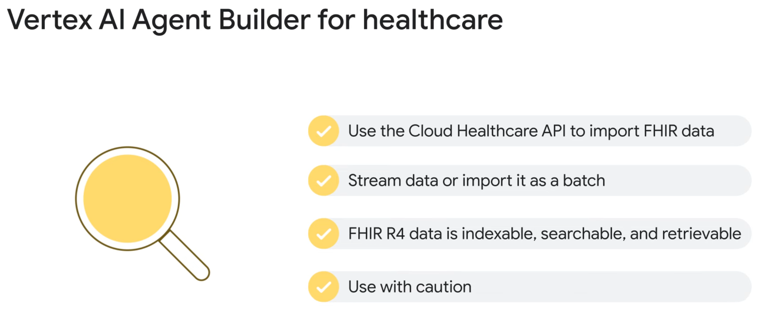

Slide 18
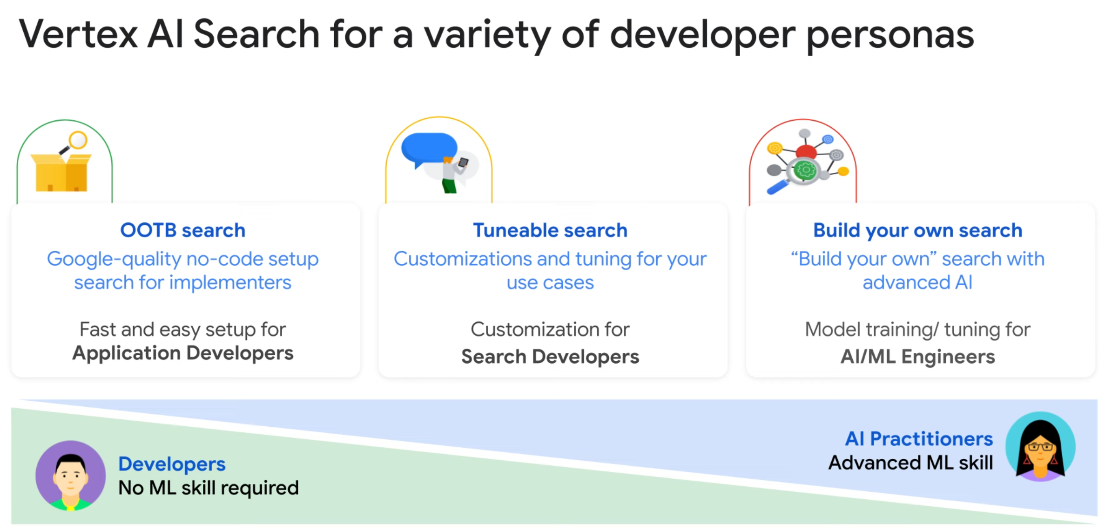

Slide 19


